Slide 1

Spring Boot + Jersey – Role Based Security with JAX-RS Annotations
Postman client
SpringBootDemo
DB
Consuming a RESTful
Web Services by using Postman client
REST API end points to Create/Update/Get/delete/Get list of Employee details
We will create JAX-RS 2.0 REST APIs using Spring Boot and Jersey framework, and add role based security using JAX-RS annotations e.g. @PermitAll, @RolesAllowed or @DenyAll.

Slide 2
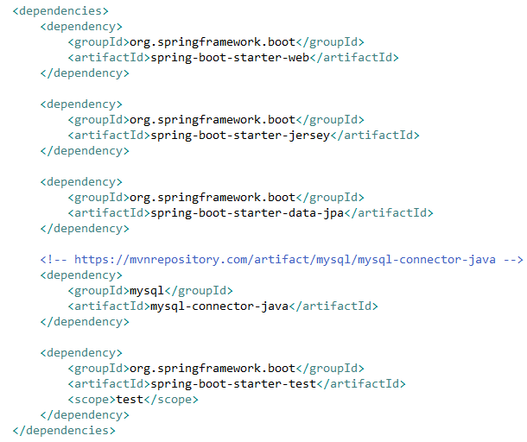
Spring Boot - Building Restful Web Services With Jersey + JPA

Slide 3
Spring Boot + Jersey – Role Based Security with JAX-RS Annotations
Security filter which will examine the incoming requests, fetch the authorization information (basic auth in this example)
Security filter will match
user name and password
Security filter will verify the user’s access level by it’s role
If user have permission then API will be accessed else user will get access denied response.
Request
Security Filter
Security filter which will examine the incoming requests, fetch the authorization information (basic auth in this example), and then will match user name and password, and finally it will verify the user’s access level by it’s role. If everything matches, API will be accessed else user will get access denied response.

Slide 4
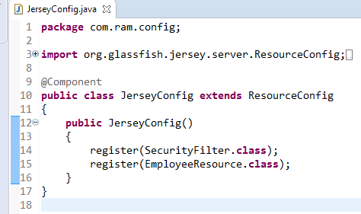
Spring Boot + Jersey – Role Based Security with JAX-RS Annotations
Now we have a JAX-RS resource and we want to access it from spring boot application which include Jersey dependency. Let’s register this resource as Jersey resource.
Look at the @Component annotation. It enables this class to be registered while spring boot auto scans the java classes in source folder.
ResourceConfig provides advanced capabilities to simplify registration of JAX-RS components.
SecurityFilter class is the actual auth details processor

Slide 5
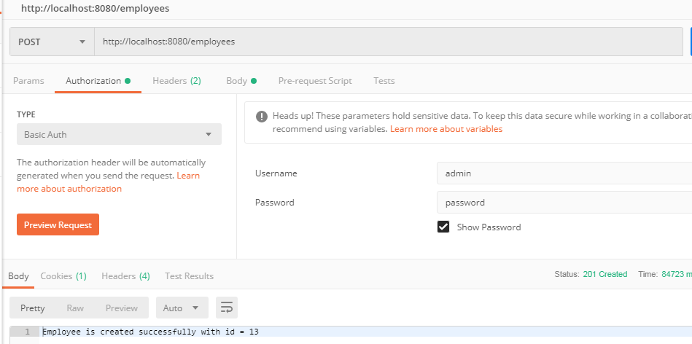
Spring Boot + Jersey – Role Based Security with JAX-RS Annotations

